Slide 1

Deep Learning with Python
Chapter
5.1-5.2
Book Reading Group
Åke Edlund, Daniel Edsgärd

Slide 2
Session outline – 60 min
Quick summary of the week’s reading, 1-2 slides (5-10 min)
Group discussions (25 min)
See Groups (with place for changes) in Wiki
Discussing this week’s reading
Addressing N number of questions (assigned to the group)
Write your answers directly into the MS Teams Forms + update this ppt (see last slides)
Group presentations of answer slides (~5min/group)
Open discussion, all to particicpate
Summary, wrap up, next session (5 min)
Note: after session, we will update the wiki and files with above input.

Slide 3
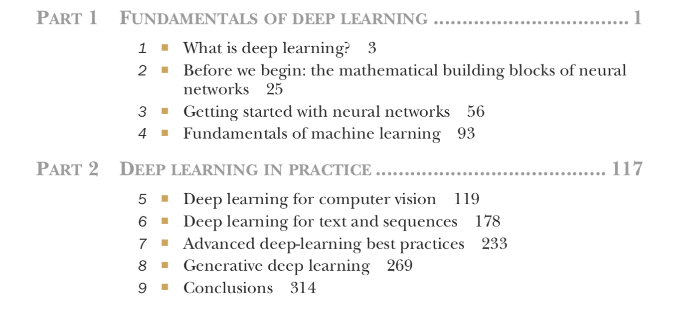
Timeplan
Sep 13 - Chapter 1-2
Sep 20 - Chapter 3
Sep 27 - Chapter 4
Oct 4 - Chapter 5.1-5.2
Oct 11 - Chapter 5.3-5.5
Oct 18 - Chapter 6.1-6.2
Oct 25 - Chapter 6.3-6.5
Nov 1 - Chapter 7
Nov 8 - Chapter 8.1-8.3
Nov 15 - Chapter 8.4-8.6
Nov 22 - Chapter 9

Slide 4
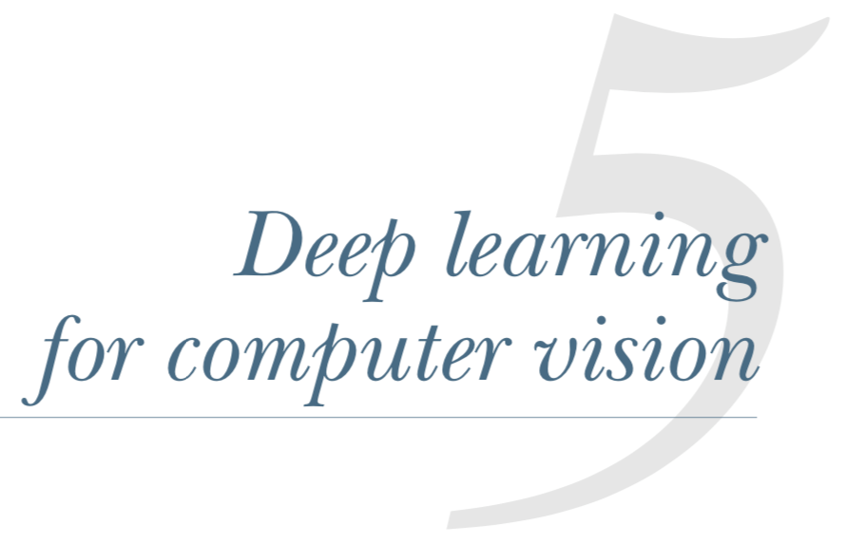
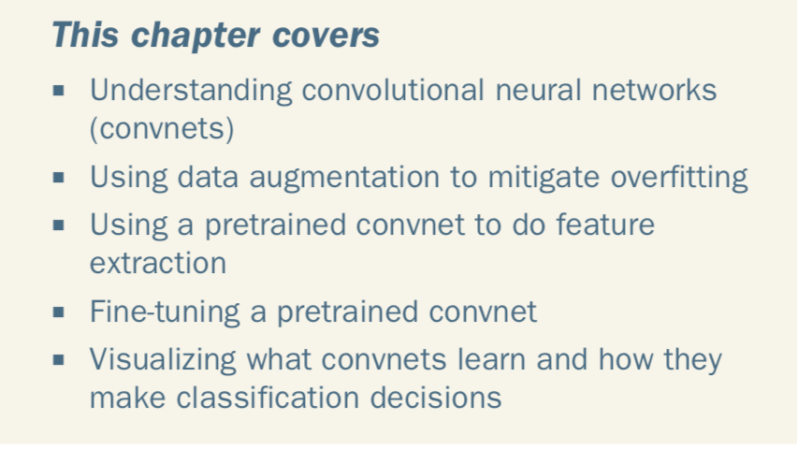
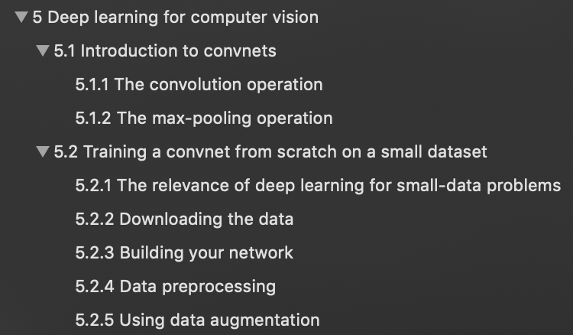

Slide 5
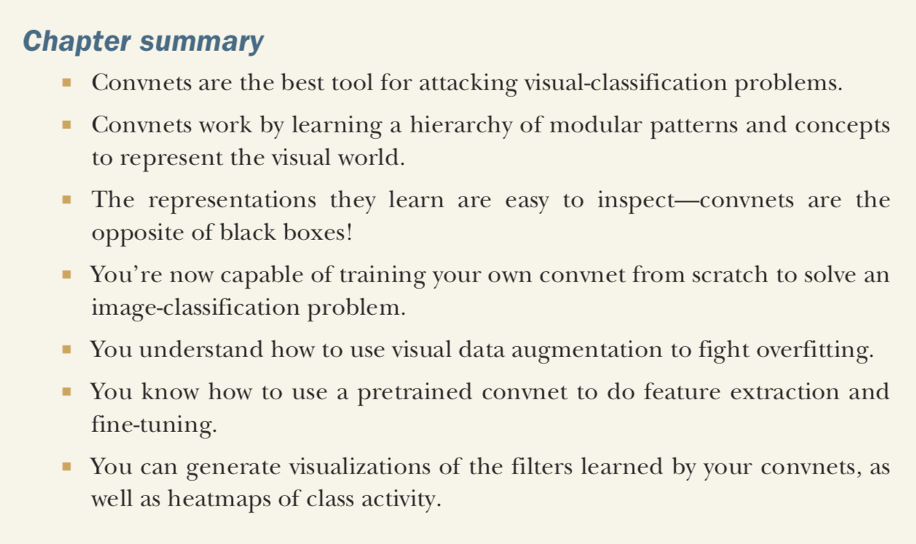

Slide 6
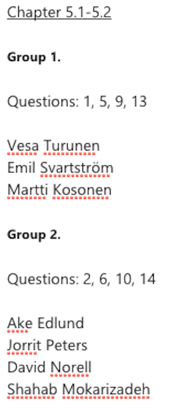
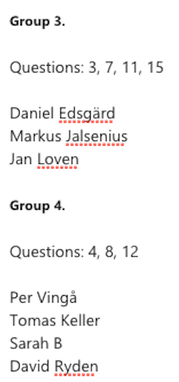

Slide 7
Group 1, Questions: 1, 5, 9, 13
1. What makes Convolutional Networks specifically applicable to image recognition (why not in NLP domain)? is there any hints to know where else we can use convolutional networks? (Shahab)
Convolution networks are three dimensional (width, height, depth) and can recognise repeating patterns in pictures after training
5. You can increase your training data by shifting images and rotating them. As convnets lear local patterns this could lead to overfitting on a particular set of images. Any rules of thumb how many times a image can be modified to increase training data? (Tomas Keller)
Without experience hard to make a rule of thumb here, but would guess it could be learnt by trial&error

Slide 8
Group 1, Questions: 1, 5, 9, 13
9. The window size is in both the MNIST and Dog and Cat example set to 3x3. It is mentioned that the most common ones are 3x3 and 5x5. What impact has the window size and are there problems where it can gain from a larger window size? (Jan Lovén)
1. Model would recognise more various patterns when grid is larger. Therefore using large grid could give better accuracy, but may also increase overfitting.
13. I've seen sometimes people suggest to use batch normalization instead of droput for convolutional networks, why and what is the difference? AFAIK, batch normalization should be used for improving optimization. So how can that be used for regularization instaed of droput? (Sarah)
We would approach this problem by testing.

Slide 9
Group 2, Questions: 2, 6, 10, 14
2. Is it ever negative to use padding? To me it seems more logical to have padding="same" as a default in Keras, as it's an important setting in e.g. deeper neural networks. (David Rydén)
You usually pad with 0 so perhaps sometimes you might lose or it might not be the most correct thing to impute that missing value with 0. "There are couple of reasons padding is important: It's easier to design networks if you preserve height and width and don't have to worry too much about tensor dimensions when going from one layer to another because dimensions will just "work". It allows us to design deeper networks. Without padding, reduction in volume size would reduce to quickly. Padding actually improves performance by keeping information at the borders." With 'same' you will perform convolution on the full area. Source: https://stats.stackexchange.com/questions/246512/convolutional-layers-to-pad-or-not-to-pad
6. There is (so far) always a 50/50 split when classifying two categories, is this because a 10/90 split would be biased to favour the big class? What do we do when we have a 10/90 split at hand? (Tomas Keller)
One can: -Sample the overrepresented class -One can draw more sample from the underrepresented class (booststrapping) -Generate more samples -Increase the loss weight of the smaller class

Slide 10
Group 2, Questions: 2, 6, 10, 14
10. In chap 5.1.2 they mention that excluding the pooling causes only having information from 7x7 windows in the 3rd layer patches. Am I correct in calculating it to be 19x19 windows if including the two pooling layers? (Daniel Edsgärd)
We ended at 18x18 We end (last layer) and work backwards and look one output so 1x1 => (by a 3x3 filter) => 3x3 => (by max pooling) => 6x6 => (by 3x3 filter) 8x8 => (by max pooling) 16x16 => (by 3x3 filter) 18x18 The stride of the original 18x18 can be seen as 2 x nr max pooling according to Markus and Jorrit, but we are not 100% sure
14. Hints on finding pre-trained networks for image recognition? (Emil Svartström)
See transfer learning, and e.g. https://www.tensorflow.org/hub/tutorials/image_retraining. Major idea: look at similar problems as the one you're solving, then transfer weights and architecture from that project. Now, depending on how much compute power you have you can chose to retrain the latter part on your own labelled data. E.g. using results from face recognition project for a new project classifying hairstyles.

Slide 11
Group 3, Questions: 3, 7, 11, 15
3. In the last example he adds a dropout layer in the end to reduce overfitting. In a convnet, can you place a dropout layer everywhere (theoritically) and is there a best practice of where to place the dropout layer in the network structure?(Jorrit Peters)
https://stats.stackexchange.com/questions/240305/where-should-i-place-dropout-layers-in-a-neural-network In the original paper that proposed dropout layers, by Hinton (2012), dropout (with p=0.5) was used on each of the fully connected (dense) layers before the output; it was not used on the convolutional layers. This became the most commonly used configuration. More recent research has shown some value in applying dropout also to convolutional layers, although at much lower levels: p=0.1 or 0.2. http://mipal.snu.ac.kr/images/1/16/Dropout_ACCV2016.pdf
7. The number of parameters listed from the model.summary() method confuse me slightly. I would have thought that the number of parameters for a Conv2D layer is the product of the number of elements of the input tensor and the output depth. E.g., transforming a 3x3x1 tensor into an array of length 32 (the conv2d_1 layer in Section 5.1) gives 3x3x1x32=288 weights. However, the number of parameters is listed as 320. The discrepancy equals the output depth. For a dense layer this discrepancy seems to equal the number of output units. What are these additional parameters? (Markus Jalsenius)
Bias term (it's a linear transformation).

Slide 12
Group 3, Questions: 3, 7, 11, 15
11. Is it informative to directly visualize the convolutional kernel corresponding to the first layer filters? In later sections of the chapter they seem to derive the input image that would maximize the activation of a filter. I understand it can be hard to interpret the convolution kernel in later layers as the input then is not the original image, but for the first layer it may be interpretable? (Daniel Edsgärd)
Yes, should be interpretable
15. Is changing parameters such as the size of the patches extracted from the inputs (3x3) to (5x5) also considered fine tuning? (Vesa Turunen)
Smaller inital fine tuning would be just to retrain some upper parts of your convbase with your own data. Starting to also change the params of the convbase is probably a later step if your performance was not good enough.

Slide 13
Group 4, Questions: 4, 8, 12
4. Is it easier to classify colour images than b/w ? The color would arguably add some information but why? (Tomas Keller)
It is mainly an empirical question how much value is added through color, if you e.g. were to classify apples of granny smith vs red delicous it is probably valuable. In the case of dogs and cats it is less obvious how valuable the colour is, and also in practice many models are done in greyscale as it is often good enough.
8. The cat and dog images were initially resized to input size 150 x 150 which the author mentioned as a somewhat arbitrary choice. This seems like quite an important step. Do you have any further information on good practices on chosing the initial image resolution to transform to and on what factors it might depend on (complexity of the problem, number of training sampels, resolution of source images etc)? (David Norell)
This is typically a question about the size of your network combined with what GPU power is available. You can afford larger pictures with more GPU and/or smaller network, and of course larger pictures contain more details. How valuable these details are depends on what you're looking for: something very small in the back of the picture or something that typically is focused upon. We found this rule of thumb: "So the rule of thumb is use images about 256x256 for ImageNet-scale networks and about 96x96 for something smaller and easier. I have heard that in kaggle people train on 512x512 sometimes, but you will need to compromise on something. Or just buy gpu cluster. " Source:https://www.quora.com/To-what-resolution-should-I-resize-my-images-to-use-as-training-dataset-for-deep-learning
12. The dropout should only be applied in training phase not in the test. How can we take care of that in Keras? (Sarah)
Keras takes care of this automatically as there's no reason for having dropout at the test-phase

